Slide 1
Software Engineering Software Engineering from 20, 000 Feet
Dr. Kamal Beydoun
Faculty of Sciences I
Lebanese University
There are two ways of constructing a software design. One way is to make it so simple that there are obviously no deficiencies. The other way is to make it so complicated that there are no obvious deficiencies. The first method is far more difficult.
—C.A.R. Hoare

Slide 2
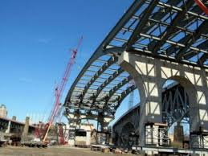

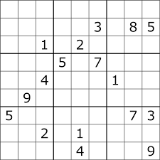
Introduction
In many ways, software engineering is a lot like other kinds of engineering.
Whether you’re building a bridge, an airplane, or a new and improved version of Sudoku, you need to accomplish certain tasks.

Slide 3
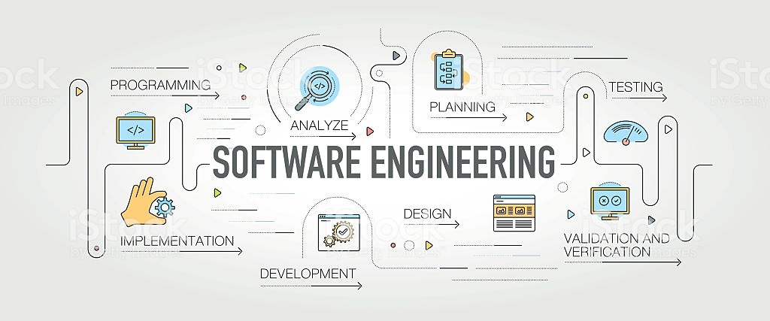
Steps or Tasks in Software Engineering
Requirements Gathering
High-Level Design
Low-Level Design
Development
Testing
Deployment
Maintenance
Wrap-Up

Slide 4
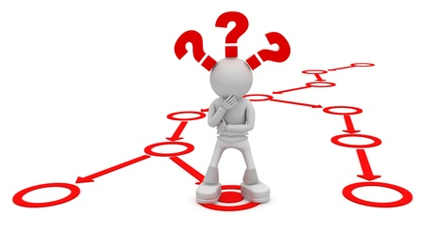
Requirements Gathering
One of the first steps in a software project is figuring out the requirements.
You need to find out:
what the customers want and what the customers need.
Depending on how well defined the user’s needs are, this can be time‐consuming.

Slide 5
Requirements Gathering : Who’s the Customer?
If you’re writing software for another part of your own company, it may be clear who the customers are.
In that case, you can sit down with them and talk about what the software should do.
In other cases, you may have only a vague notion of who will use the finished software.
For example, if you’re creating a new online card game, it may be hard to identify the customers until after you start marketing the game.
Sometimes, you may even be the customer. I write software for myself all the time.
In any project, you should try to identify your customers and interact with them as much as possible so that you can design the most useful application possible.

Slide 6
Requirements Gathering
After you determine the customers’ wants and needs (which are not always the same), you can turn them into requirements documents.
tell the customers what they will be getting,
tell the project members what they will be building.
Throughout the project, both customers and team members can refer to the requirements to see if the project is heading in the right direction.
Notes:
If someone suggests that the project should include a video tutorial, you can see if that was included in the requirements. If this is a new feature, you might allow that change if it would be useful and wouldn’t mess up the rest of the schedule. If that request doesn’t make sense, either because it wouldn’t add value to the project or you can’t do it with the time you have, then you may need to defer it for a later release.

Slide 7
Change Happens !!
Software doesn’t exist in any physical way.
Because software is so flexible, users frequently ask for new features up to the day before the release party.
switching database platforms or even hardware platforms
“The program is just 0s and 1s,” they reason.
Notes:
In contrast, a company wouldn’t ask an architectural firm to move a new convention center across the street at the last minute; a city transportation authority wouldn’t ask the builder to add an extra lane to a freeway bridge right after it opens; and no one would try to insert an atrium level at the bottom of a newly completed 90‐story building.

Slide 8
High‐Level Design
The high‐level design includes such things as decisions about
what platform to use (such as desktop, laptop, tablet, or phone),
what data design to use (such as direct access, 2‐tier, or 3‐tier),
and interfaces with other systems (such as external purchasing systems).
The high‐level design should also include information about the project architecture at a relatively high level.

Slide 9
Example
suppose you’re building a system to manage the results of ostrich races. You might decide the project needs the following major pieces:
Database (to hold the data)
Classes (for example, Race, Ostrich, and Jockey classes)
User interfaces (to enter Ostrich and Jockey data, enter race results, produce result reports, and create new races)
External interfaces (to send information and spam to participants and fans via e‐mail, text message, voice mail, and anything else we can think of)
You should make sure that the high‐level design covers every aspect of the requirements.

Slide 10
Low‐Level Design
After your high‐level design breaks the project into pieces, you can assign those pieces to groups within the project so that they can work on low‐level designs.
The low‐level design includes information about how that piece of the project should work.
The design doesn’t need to give every last detail necessary to implement the project’s major pieces,
they should give enough guidance to the developers who will implement those pieces.
Notes:
For example, the ostrich racing application’s database piece would include an initial design for the database. It should sketch out the tables that will hold the race, ostrich, and jockey information. At this point you will also discover interactions between the different pieces of the project that may require changes here and there. The ostrich project’s external interfaces might require a new table to
hold e‐mail, text messaging, and other information for fans.

Slide 11

Development
After you’ve created the high‐ and low‐level designs, it’s time for the programmers to get to work.
The programmers continue refining the low‐level designs until they know how to implement those designs in code.
As the programmers write the code, they test it to find and remove as many bugs as they reasonably can.

Slide 12
Testing
Effectively testing your own code is extremely hard.
If you just wrote the code, you obviously didn’t insert bugs intentionally.
Even if a particular piece of code is thoroughly tested and contains no (or few) bugs,
No guarantee that it will work properly with the other parts of the system.
First developers test their own code.
Then testers who didn’t write the code test it.
After a piece of code seems to work properly, it is integrated into the rest of the project, and the whole thing is tested to see if the new code broke anything.
Notes:
Any time a test fails, the programmers dive back into the code to fi gure out what’s going wrong and
how to fi x it. After any repairs, the code goes back into the queue for retesting.

Slide 13
Testing
Unfortunately fixing a bug often creates a new bug.
Sometimes the bug fix is incorrect.
Other times it breaks another piece of code that depended on the original buggy behavior.
the programmer might change some correct behavior to a different correct behavior without realizing that some other code depended on the original correct behavior.
“Testing shows the presence, not the absence of bugs.”

Slide 14
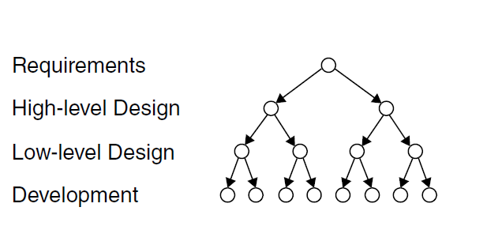
Example: Counting Bugs
Suppose requirements gathering, high‐level design, low‐level design, and development works like this:
Every time you make a decision, the next task in the sequence includes two more decisions that depend on the first one.
If you detect the error during the requirements gathering phase, you need to fix only that one error. But…
The longer a bug remains undetected, the harder it is to fix.

Slide 15
Deployment
Deployment can be difficult, time‐consuming, and expensive. suppose you’ve written a new billing system to track payments from your company’s millions of customers.
Deployment might involve any or all of the following:
New computers for the back-end database
A new network
New computers for the users
User training
On-site support while the users get to know the new system
Parallel operations while some users get to know the new system and other users keep using the old system
Special data maintenance tasks to keep the old and new databases synchronized
Massive bug fixing when the 250 users discover dozens or hundreds of bugs that testing didn’t uncover
Other nonsense that no one could possibly predict

Slide 16
Maintenance
As soon as the users start pounding away on your software, they’ll find bugs.
If your application is successful, users also think up a slew of enhancements, improvements, and new features that they want added immediately.
Customers that like an application so much, they’re clamoring for more. It’s the goal of every software engineering project, but it does mean more work.

Slide 17
Wrap‐up
You need to perform an examination.
You need to evaluate the project and decide what went right and what went wrong.
You need to figure out how to make the things that went well occur more often in the future.
You need to determine how to prevent the things that went badly in the future.

Slide 18
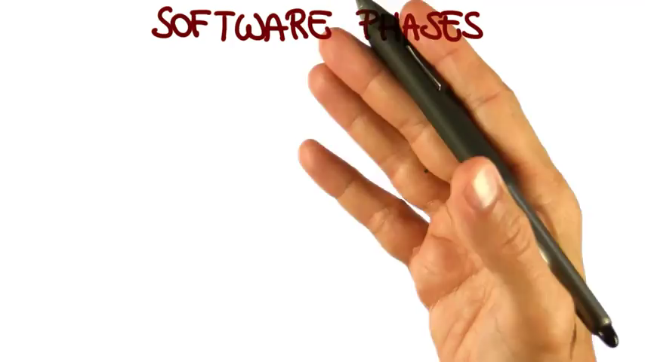
Videos – Software Phases

Slide 19
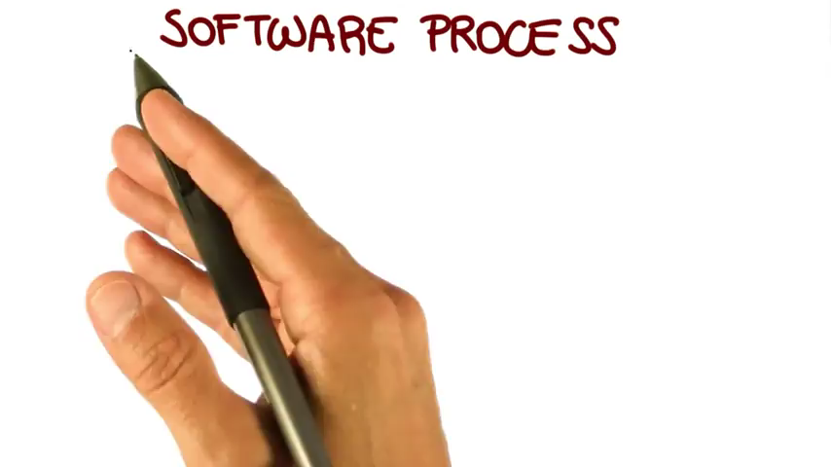
Videos – Software Process

Slide 20

Videos – Tools of the Trade

